Slide 1
EcoTrade: A Sustainable E-commerce Platform for School Supplies
Eco-Friendly Supplies for a Brighter Tomorrow

Slide 2
User Description
Students
– Can browse, purchase, and track eco-friendly school supplies.
– Can order sustainable supplies for them..

Slide 3

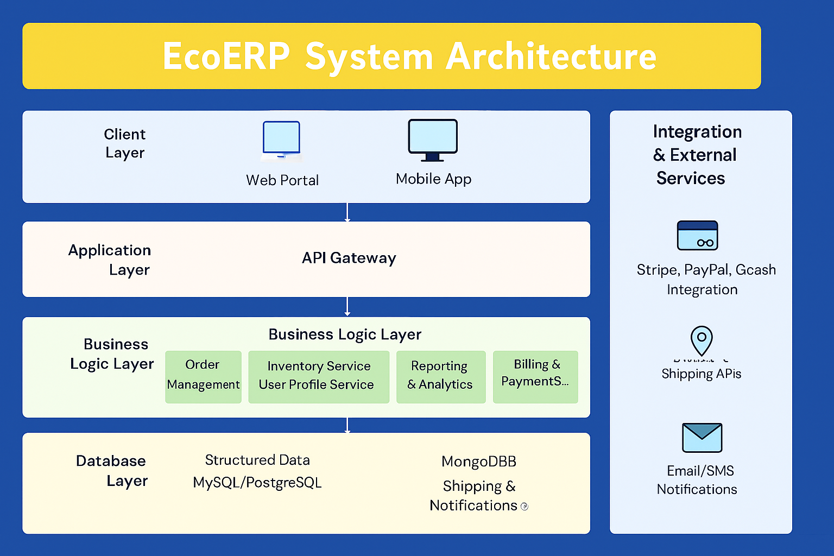
System Architecture

Slide 4
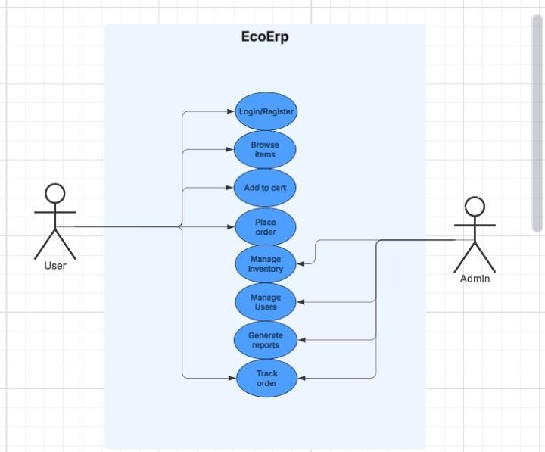
Use Case Diagram

Slide 5
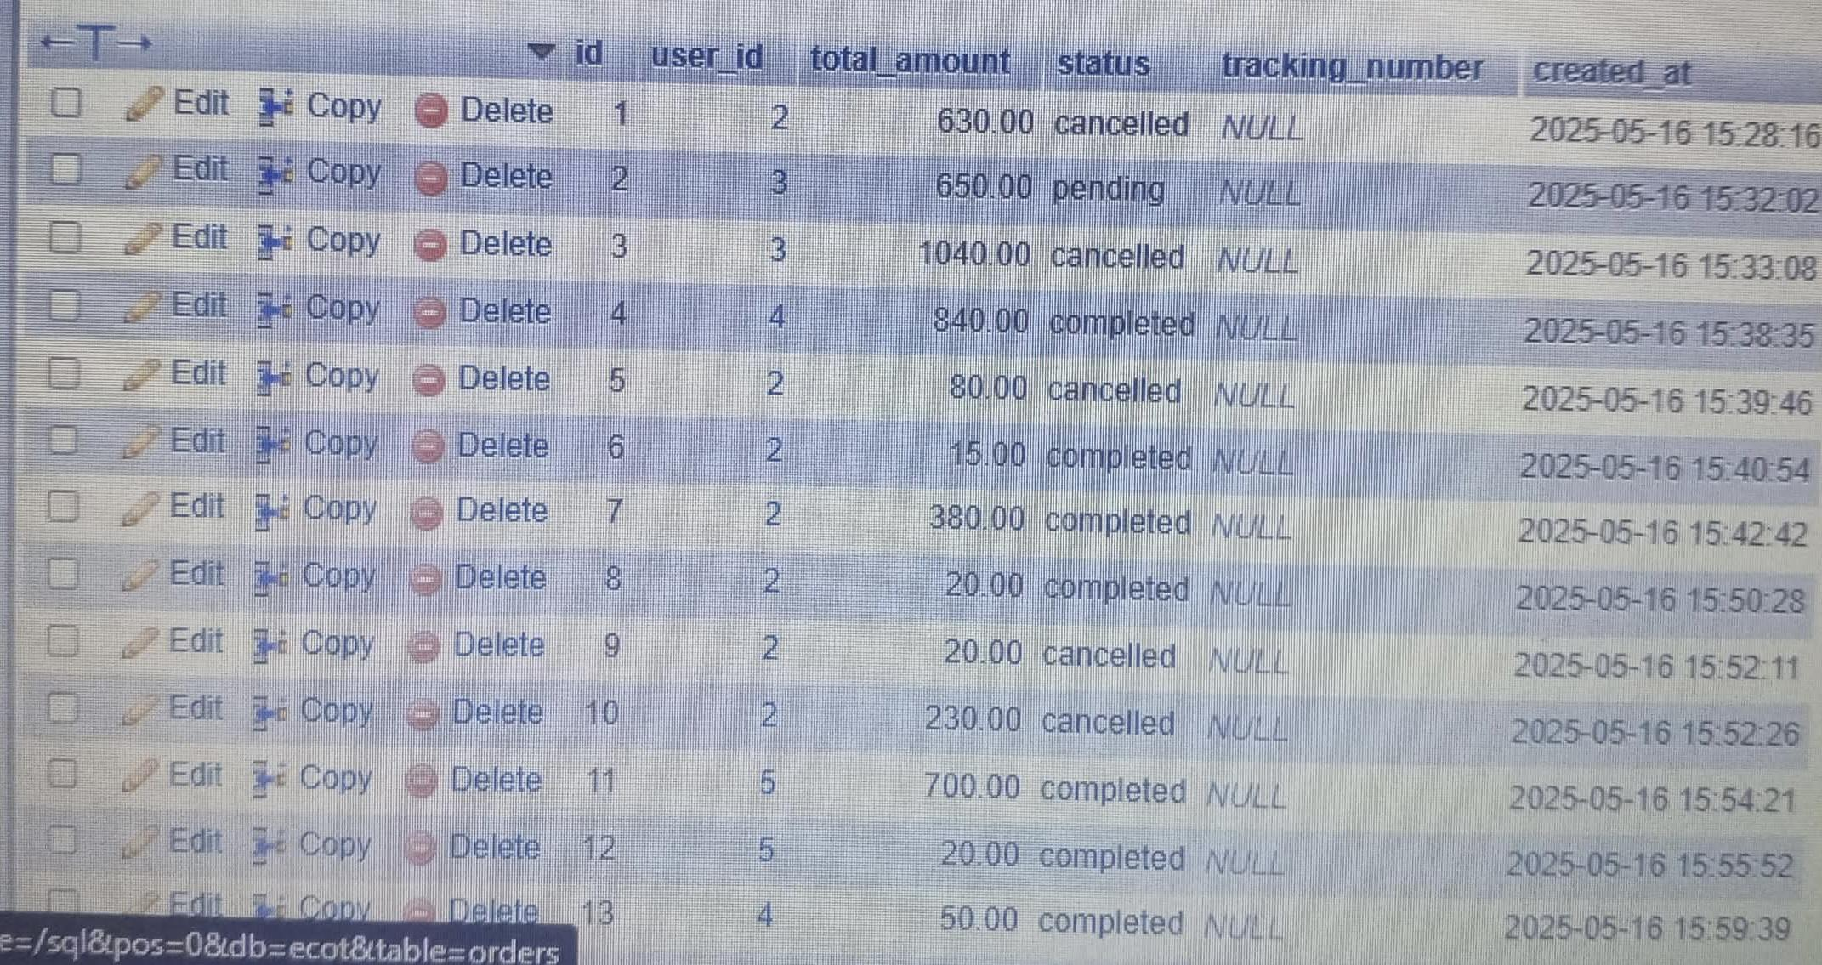
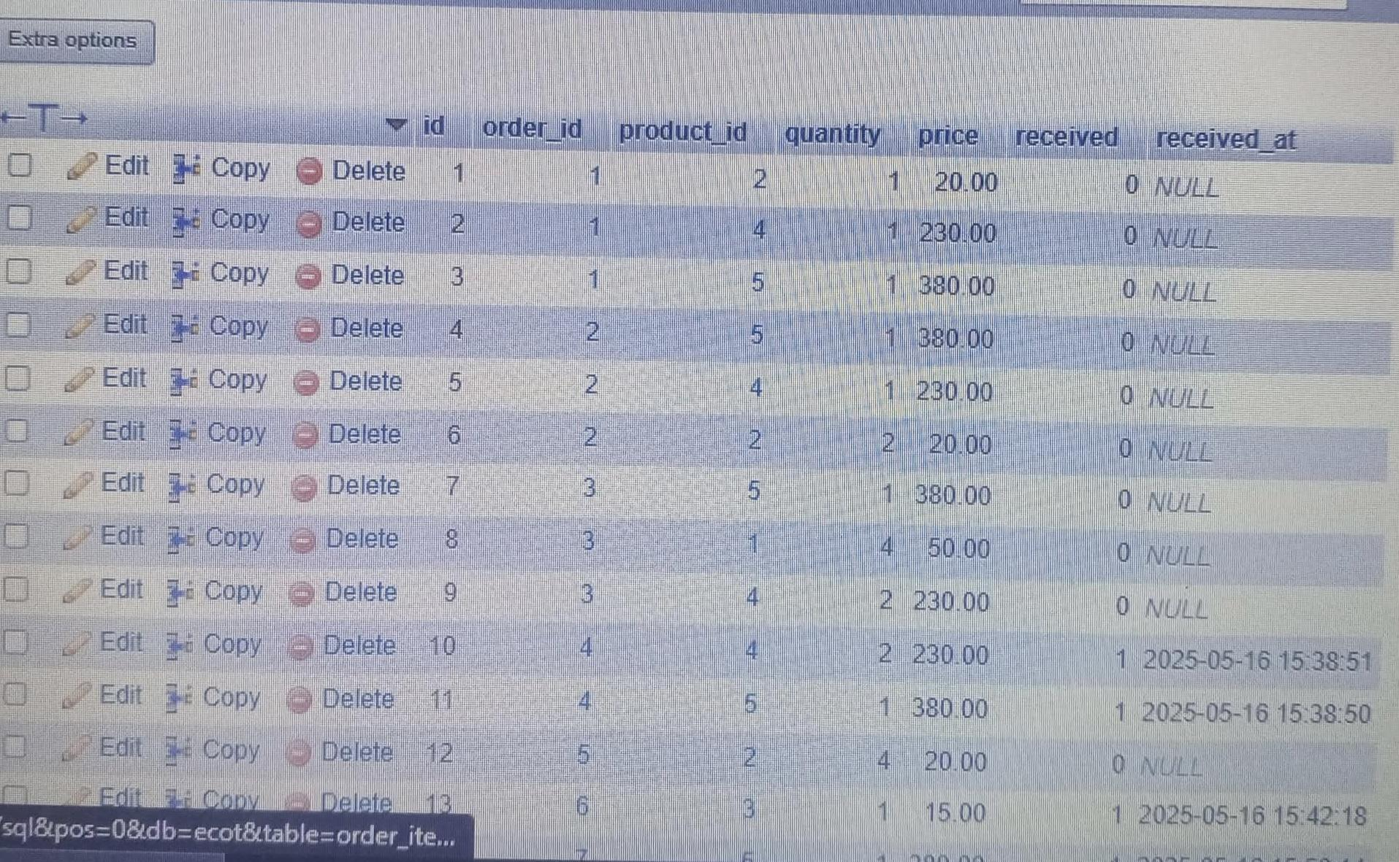
Data Dictionary

Slide 6
Database Relationship Diagram (ERD)
Relationship Type | Entities Involved | Description
1-to-Many | Users - Orders | A user can place many orders.
1-to-Many | Order - Order Items | Each order can multiple order items.
Many-to-1 | Order Items - School Supplies | Each order item is for a specific school supplies

Slide 7
Target Sustainable Development Goals (SDGs)
SDG 4 – Quality Education
Provides affordable and accessible school supplies to support learning.
SDG 12 – Responsible Consumption and Production
Encourages use of sustainable, eco-labeled school products.
SDG 13 – Climate Action
Promotes eco-conscious purchases and reduces carbon footprints.
SDG 9 – Industry, Innovation, and Infrastructure
Uses ERP technology to digitize and optimize the school supply chain.

Slide 8
Thank you.

